Slide 1
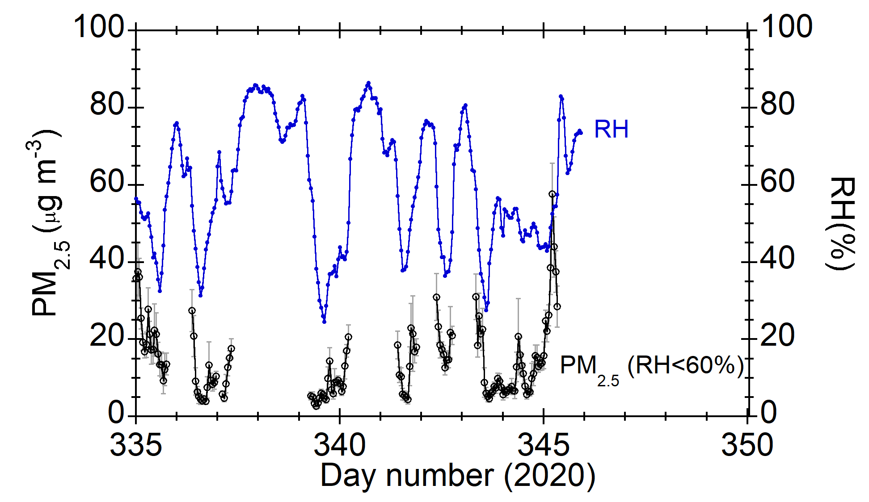
PM_{2.5} during the Chiba Campaign 2020
PM_{2.5} (measured at RH < 60%) was below ~35 μg m⁻³.

